Slide 1
Alcor Project Update
Alcor Team
Dec. 20, 2020

Slide 2
Alcor Project
Architecture Overview
Component Snapshot and Development Status
Performance Comparison with OpenStack Neutron
Scalability Test Framework
Migration Plan from Neutron
11/30 New Features
L3 Routing by Alcor Distributed Router
Distributed DHCP Programming

Slide 3
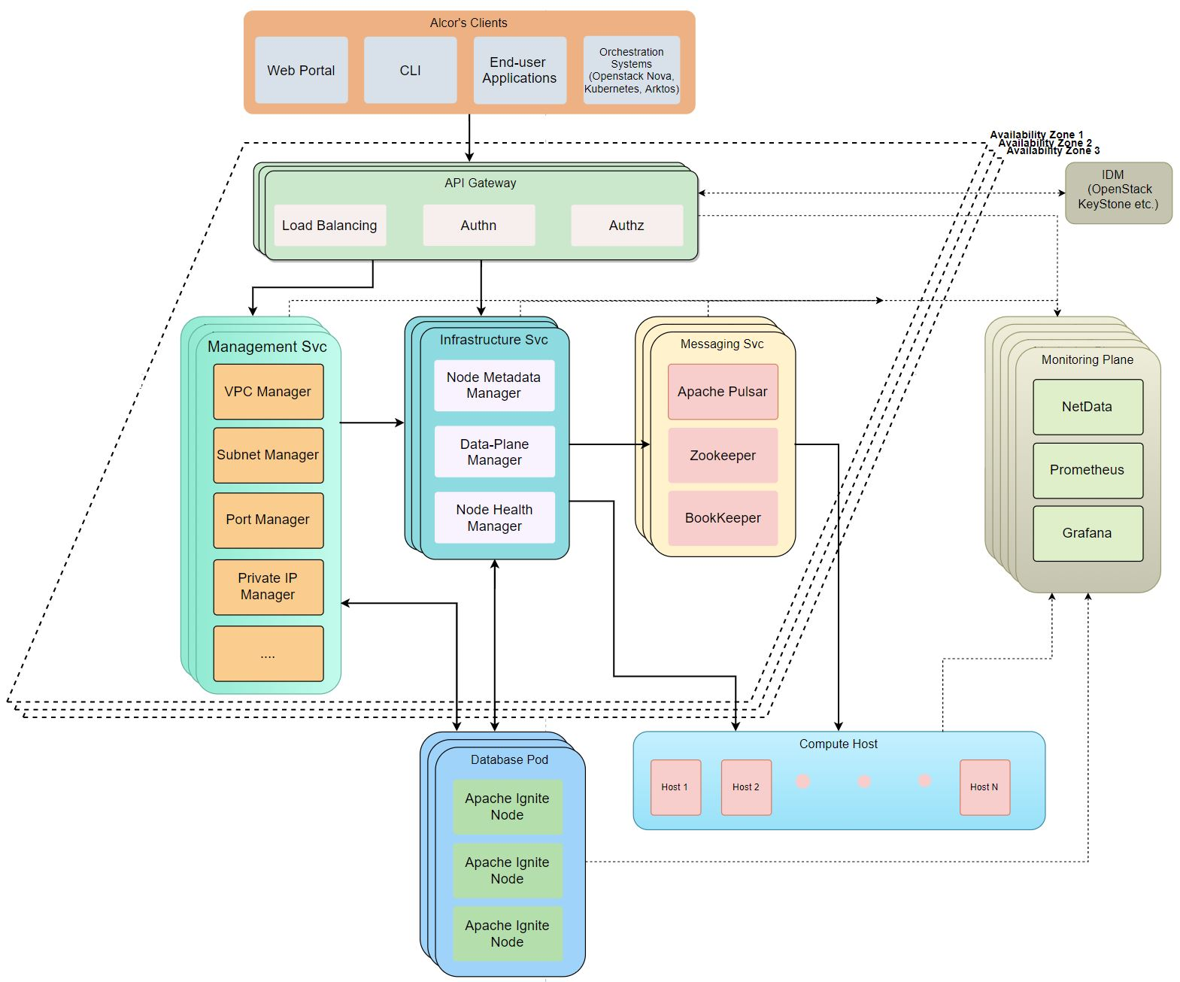
Alcor Architecture
Cloud-native architecture designed from the ground up
Fast resource provisioning
Throughput-optimal design
Multiple control paths for high availability and high reliability
Alcor performance goal
10x Latency
100x Throughput
1000x Scalability

Slide 4

Alcor Controller Innovation
Hyper-scale to support million of servers
18 microservices, each managing its own resource and scaling independently with its own DB (Ignite)
Horizontal scale-out for 1000x scalability
Decoupled resource management with in-memory DB
Ultra-Low Latency to enable new container/ serverless workload
Top-down push model for 10x latency gain (compared with bottom-up of Neutron)
Direct gRPC channel from controller to host agent for ultra-low latency
High throughput
Batch and parallel network port provisioning for 100x throughput gain
Extensive resource batching in messaging

Slide 5
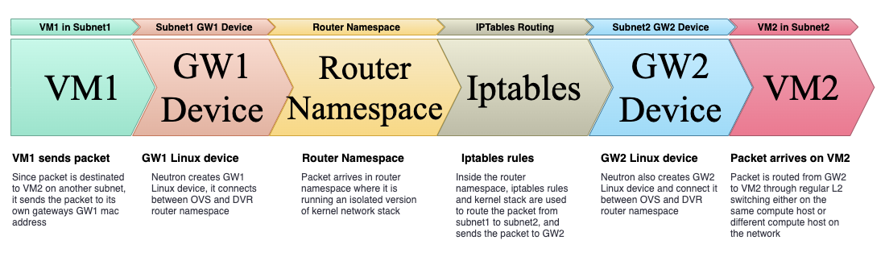
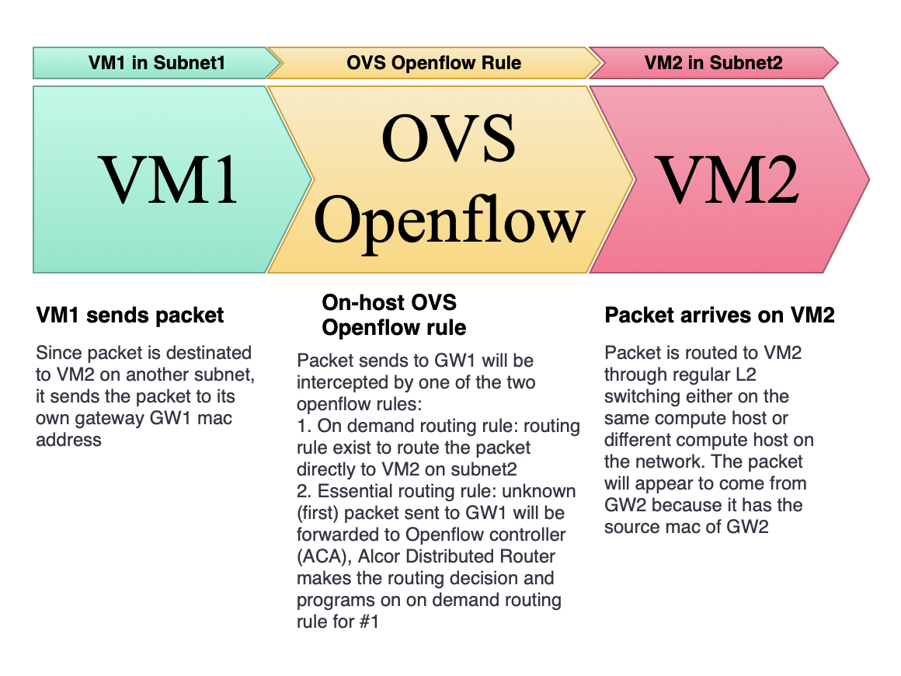
Alcor Agent Innovation
Built from the ground up with C++
Promote high performance and multiple threading
Alcor Distributed Router
Enable host-to-host direct communication for L3 routing
Use highly efficient OpenFlow rules
Eliminate namespace, Linux devices, and iptables required by Neutron DVR
On-host distributed DHCP
Proactively plumb DHCP OVS rules to compute nodes
Use local DHCP server to respond to DHCP request (compared with Neutron’s centralized DHCP server on network nodes)
Eliminate namespace, Linux devices, and Dnsmasq process required by Neutron DHCP
Neutron DVR packet flow
Alcor Distributed Router packet flow

Slide 6
Management/Control Plane – Current Design
Region1
AZ1
AZ2
Console
APIGW
组合计费编排层
组合API
VPCServer
NPCC
管理面
资源操作层
VPC
ELB
DC/VPN
EIP
GuassDB
kafka
VPC控制器
BR控制器
控制面
Cache
Kafka
Cache
Kafka
Redis
Redis
Agent
Agent
Agent
Agent
CNA
CNA
BR
BR

Slide 7
Management/Control Plane – Alcor New Design
Region1
设计目标：
管理面和控制面解耦和微服务化
管理面：提供内部及外部API, 由10+微服务独立管理资源并接受用户请求, 生成\操作相关配置对象并持久化, 通过gRPC传递变化事件
控制面：处理控制面消息, 生成转发面所需表项视图, 通过消息队列下发給物理节点Agent
管控面微服务平台: 统一管控面开发部署并减少成本
提出基于微服务理念的统一基础服务开发平台, 平台本身提供稳定和高可用, 降低管控面部署的成本, 业务开发仅关注业务逻辑
网络资源抽象, 解决耦合问题并具备面对未来的可拓展性
管控面微服务化, 每个微服务管理各自资源状态, 支持独立和灵活横向拓展
支持细颗粒灰度发布(目标支持租户级别）
简化管控面交互协议并支持全新的并行批量资源创建
大规模表项快速发放技术以支持大租户和容器场景
全新的信息定义支持多资源多场景捆绑下放, 主要场景信息交互频率是原有1/10
根据时延和规模需求, 管控面交互支持多种信息通道(gRPC fast path, MQ scaling path和HA rescue path)
性能指标有级数上的增强，同时稳定性增强
性能与Neutron最新版本相比达到1/10 Latency, 100X Throughput
高压情况下保持高可用性, 解决Neutron存在瓶颈点导致高压下的可用性问题
支持用户虚机快速启动, 网络资源下放速率达到秒级
支持用户超大VPC部署, 目标支持10万虚机级别(现网仅支持6K虚机)
单一区域的管控面目标支持30万台以上物理机（现网目前最大region 2-3万台物理机, 单一控制面可支持1万物理机）
和现网其他模块的管理面解耦
各模块管理面独立运行并北向提供内部和外部API
模块间采用API调用
AZ1
AZ2
Console
APIGW
组合计费编排层
组合API
VPCServer
NPCC
管理面
资源操作层
VPC资源管理
微服务
ELB
DC/VPN
EIP
GuassDB
gRPC
kafka
网络基础设施微服务
BR控制器
控制面
gRPC
Pulsar
Cache
Kafka
Redis
Agent
Agent
Agent
Agent
CNA
CNA
BR
BR
Alcor

Slide 8
Alcor项目总体进展和诉求
目前Alcor经过一年的设计开发，已经完成核心特性和场景的端对端验证，基本完成架构的性能验证(包括latency，throughput和concurrency)和初步的大规模场景模拟验证
已验证场景包括VM部署，Router创建，L2子网通讯，L3跨子网通讯，VM自动通过DHCP获取私有IP等。
Latency比起原生Neutron有大幅改进，API时延是Neutron的1/10, VM端对端部署时延是Neutron的1/4 （更多详细数据请看后面）
目前项目已经进入关键环节，需要产品团队共同参入到设计与开发中来，才能推进项目进一步演进。
下一步任务介绍 | 现状和诉求
大规模场景验证及与现网的性能直接比较 | 创新部网络团队正在进行, 现只有20+台服务器 缺少接近现网的大规模测试环境, 需要300+台做更大规模的性能验证, 看能否在性能部的集群上做验证
Alcor与EVS 5.0（IaaS和罗素）的集成分析和后续开发 | 现网逐渐迁移到EVS 5.0, 其与开源OVS相比已有不小的演进(不用Openflow, API不同). 这影响Alcor Agent的部分设计开发，需要有产品团队的参入和开发
Alcor作为管控面管理新的region级租户路由器Transit Gateway | 需要产品团队提供最新需求并进一步联合设计开发
Alcor支持租户级灰度上线 | 需要产品团队提供最新需求和数据面灰度支持的状态
Alcor进一步特性设计和开发 | 需要产品团队和创新部网络团队的参入和开发 Security Group：正在进行 NACL, EIP/SNAT: Agent部分待开发 与现网基础和业务网关的集成: 需要支持

Slide 9
Alcor Project
Architecture Overview
Component Snapshot and Development Status
Performance Comparison with OpenStack Neutron
Scalability Test Framework
Migration Plan from Neutron
11/30 New Features
L3 Routing by Alcor Distributed Router
Distributed DHCP Programming

Slide 10
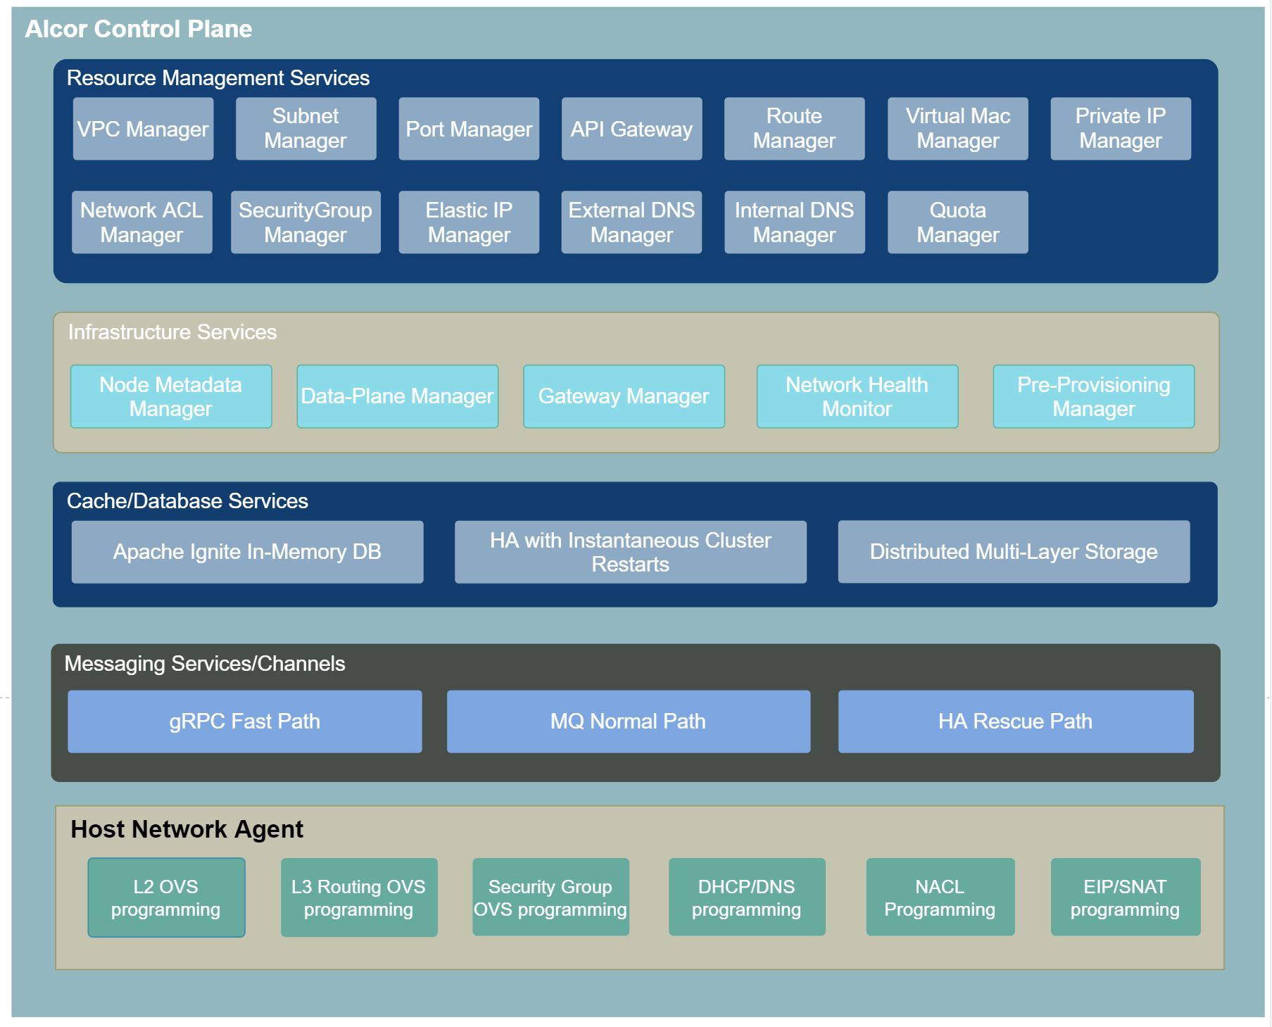
Alcor Component Snapshot

Slide 11
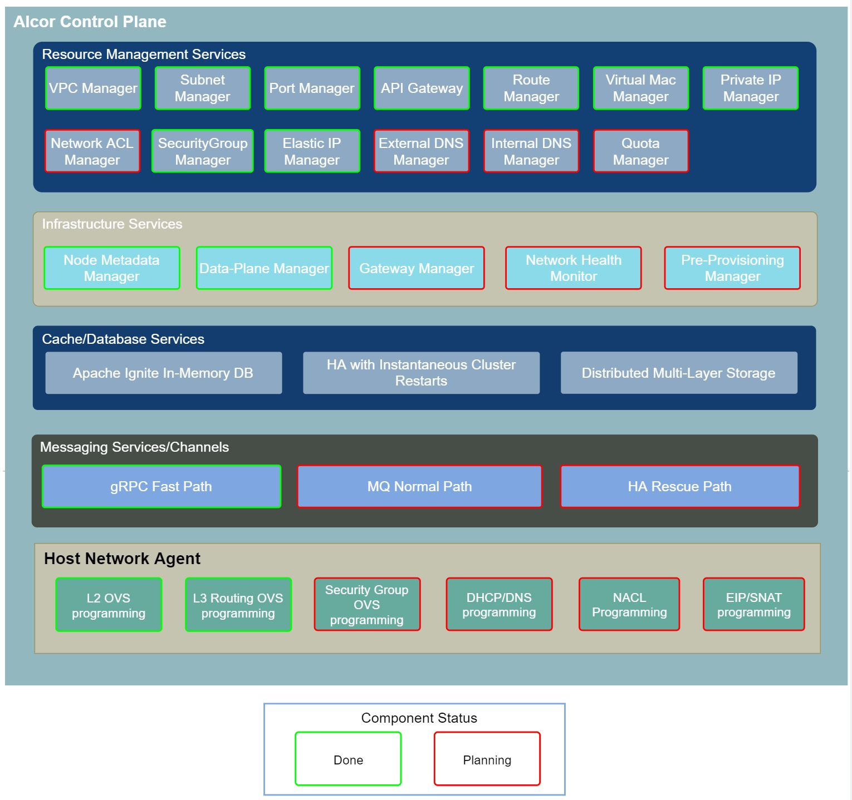
08/30 Development Status
08/30 Release: https://github.com/futurewei-cloud/alcor/releases/tag/v0.8-alpha
11 microservices delivered
gRPC fast path enabled
E2E integrated with OpenStack Nova, KeyStone, Horizon UI and CLI
Preliminary performance compared with Neutron including E2E booting VM and attaching ports
Migration plan from Neutron to Alcor is ready

Slide 12
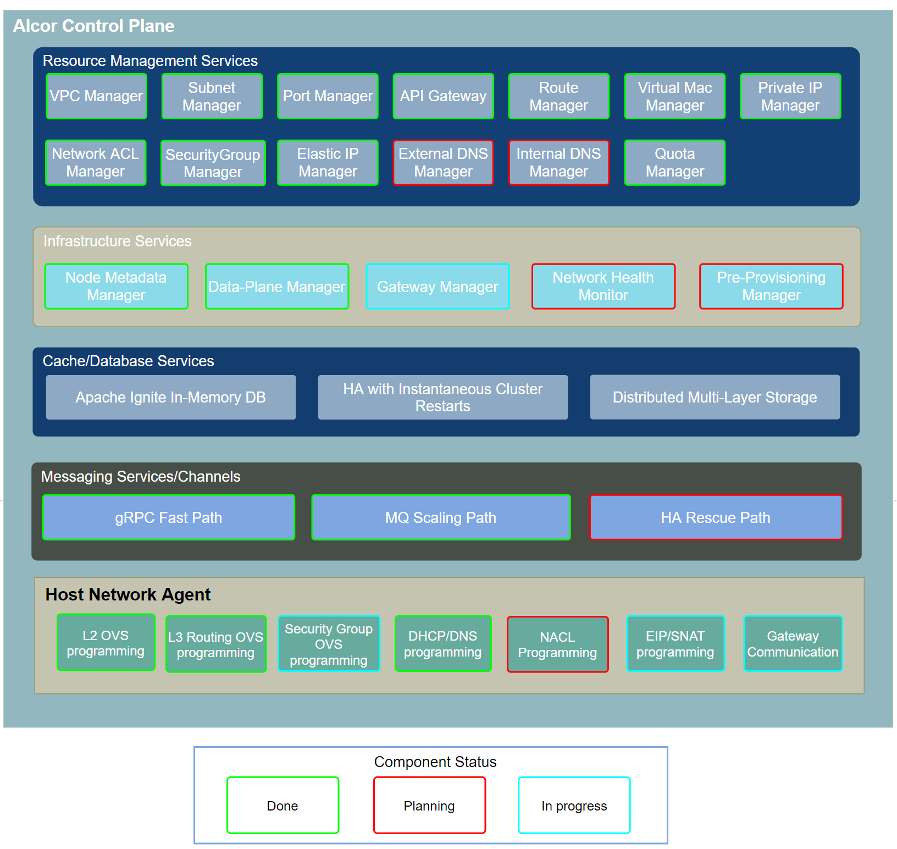
11/30 Development Status
Release: https://github.com/futurewei-cloud/alcor/releases/tag/v0.10-alpha
New Feature Design and Development
Delivery 2 new microservices (Network ACL Manager and Quota Manager), 13 microservices in total,
Refactor 2 core microservices to v2.0 (Data-Plane Manager and Route Manager)
Complete L3 routing and DHCP programming for host agent
Finish feature integration for L3 routing and DHCP
Performance and Scalability Test
Collect new latency and throughput data, on track to meet 10x latency and 100x throughput performance goal
Set up scalability test framework for 1 million simulated compute nodes
Collect preliminary scalability test results for 1 million simulated compute nodes and mega VPC scale up to 1 million ports
Messaging Services
Enable new MQ scaling path achieve sub-second port provisioning latency for large-scale customer scenario
Onboard new features on gRPC fast path
Integration with OpenStack
Complete E2E integration with OpenStack Nova, KeyStone, Horizon UI and CLI for all supported features

Slide 13
Alcor Project
Architecture Overview
Component Snapshot and Development Status
Performance Comparison with OpenStack Neutron
Scalability Test Framework
Migration Plan from Neutron
11/30 New Features
L3 Routing by Alcor Distributed Router
Distributed DHCP Programming

Slide 14
Alcor Goal on Performance & Scalability
10x latency 1/10 Latency of Neutron
100x Throughput Provisioning 100,000 ports/min
1000x Scalability Support 1,000,000 physical servers

Slide 15
Current Status on Performance & Scalability
10x latency 1/10 Latency of Neutron
Current status
Meet goal
Cut 90% of neutron latency
Reduce 75% of VM boot time
100x Throughput Provisioning 100,000 ports/min
Current Status
Achieve 10+x throughput for port related APIs
Achieve 20x concurrency for VM boot
1000x Scalability Support 300,000+ physical servers and mega vpc of 100,000 ports
Current Status
Set up test environment with 1,000,000 simulated nodes
Validate VPC of 60,000 ports

Slide 16
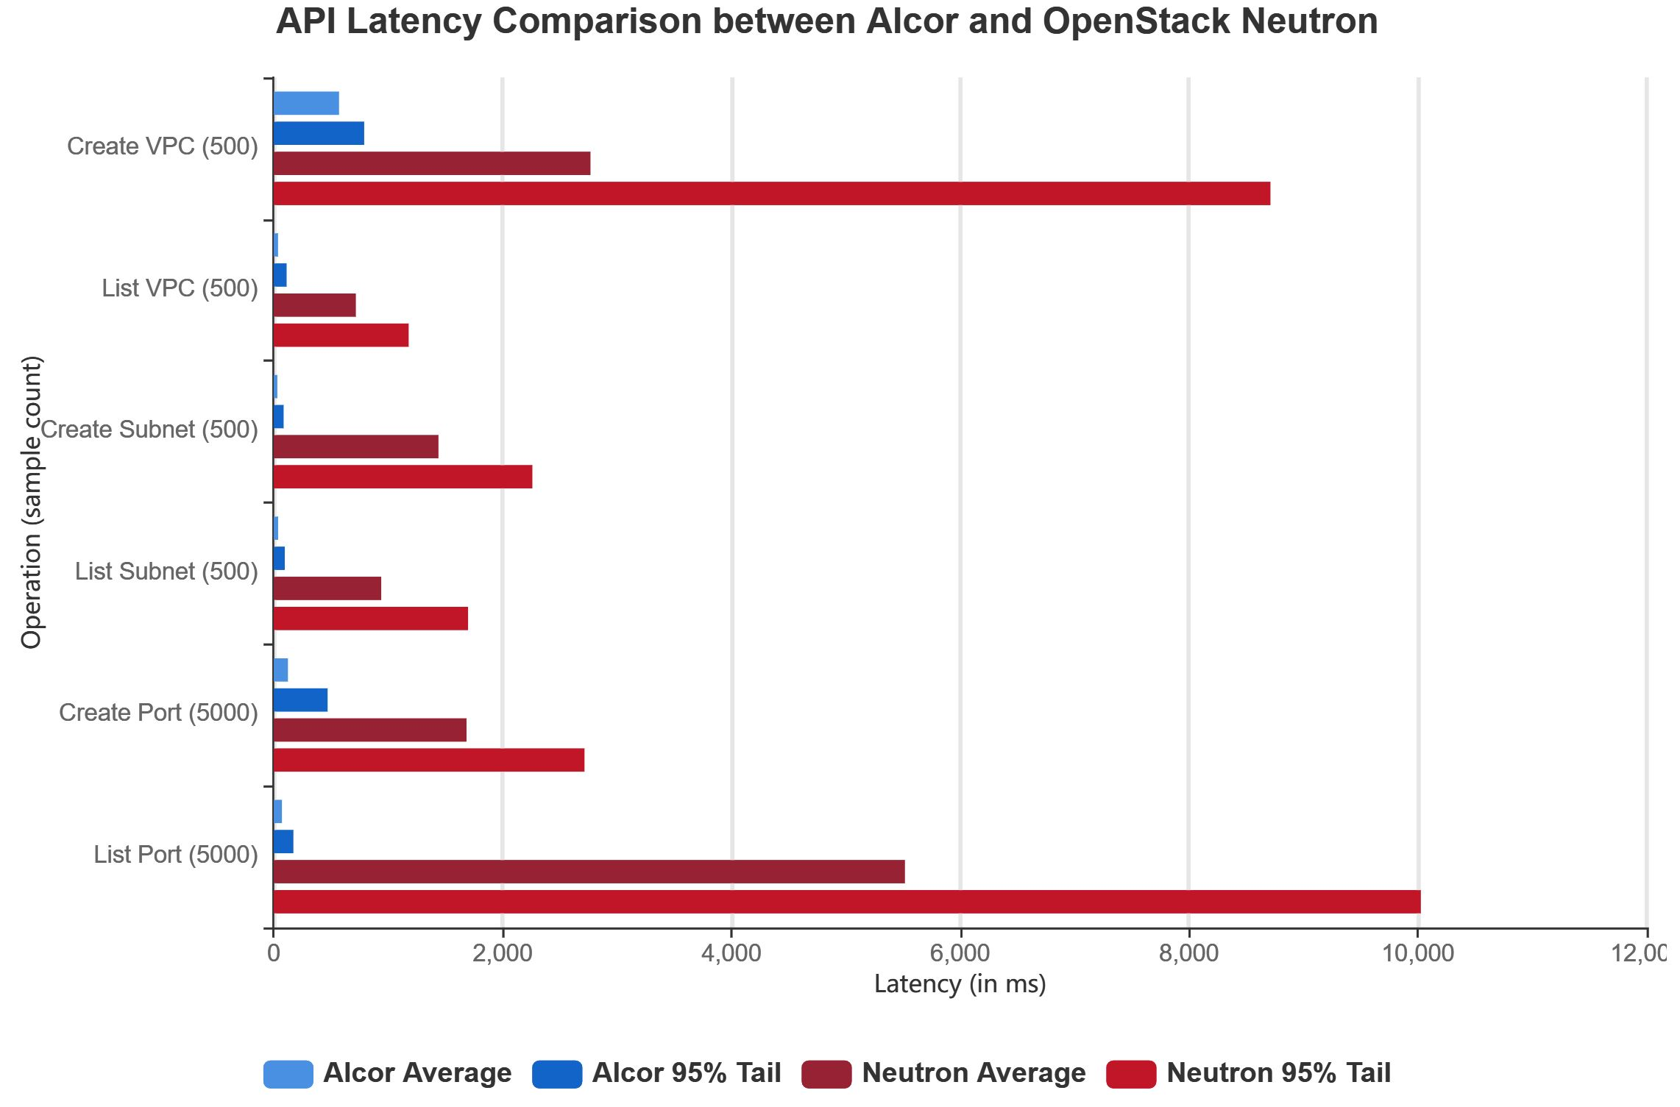
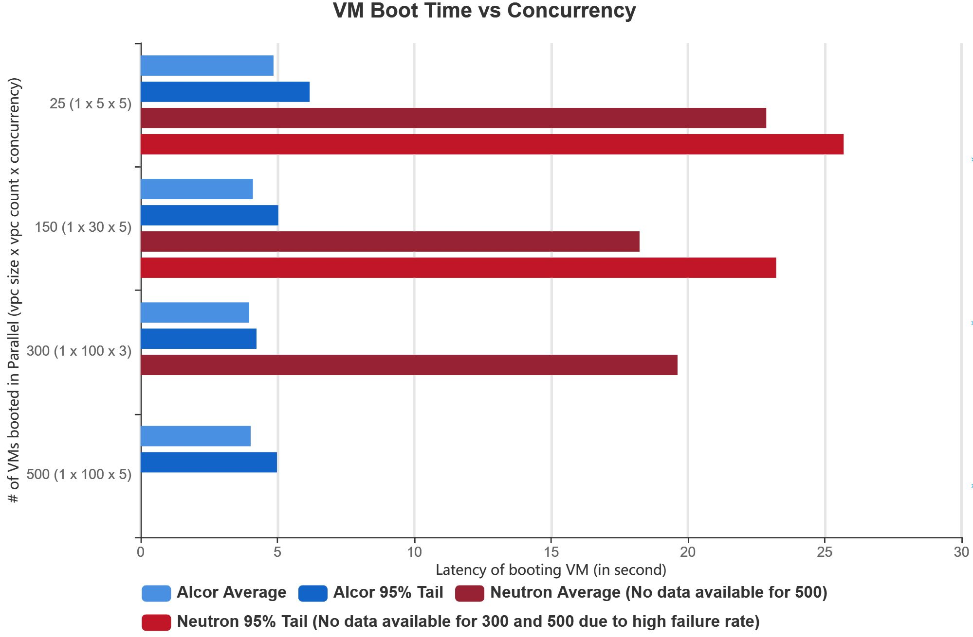
Latency Comparison
Cut 90% of Neutron latency
Reduce 75% of VM boot time and beyond
Note: Most of the Alcor REST API latency is under 200 ms due to decoupled resource modeling and distributed management with utilization of in-memory database.
Note: Neutron+Nova only reaches 23% success rate when concurrent VMs = 300 and drops to almost zero when concurrency increases to 500.

Slide 17
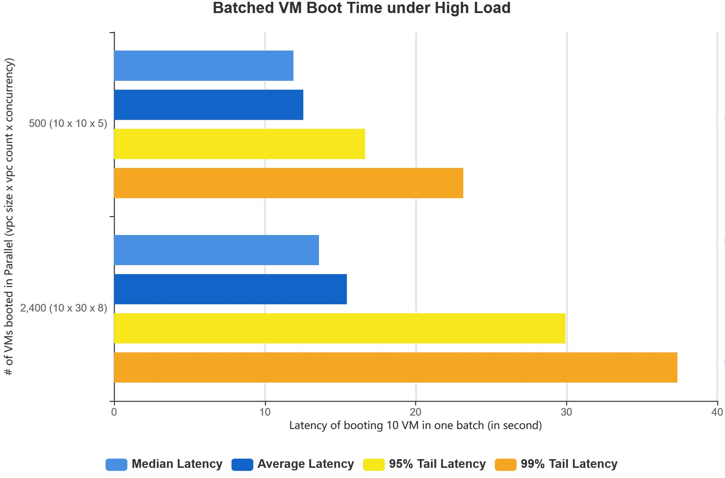
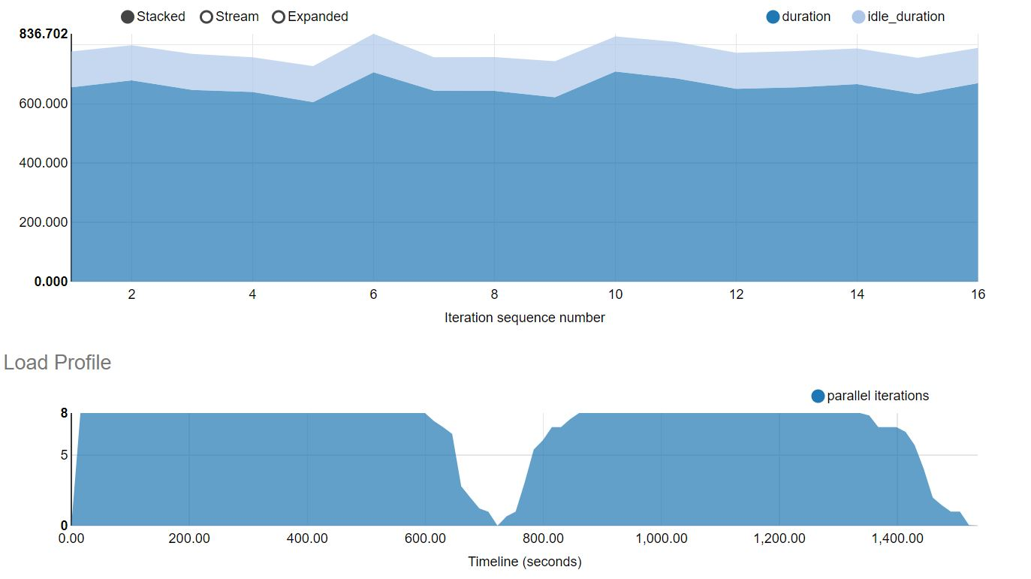
Sustainability under High Load
Support 2,400 VMs deployed in parallel to 19 compute nodes without performance degradation
Note: (1) The measured time is to boot one batch of 10 VMs, not a single VM.
(2) 2,400 VMs concurrent creation is a limit of compute capacity. Alcor not yet reached its throughput limit.
We are adding more compute capacity to find out Alcor throughput limit.

Slide 18
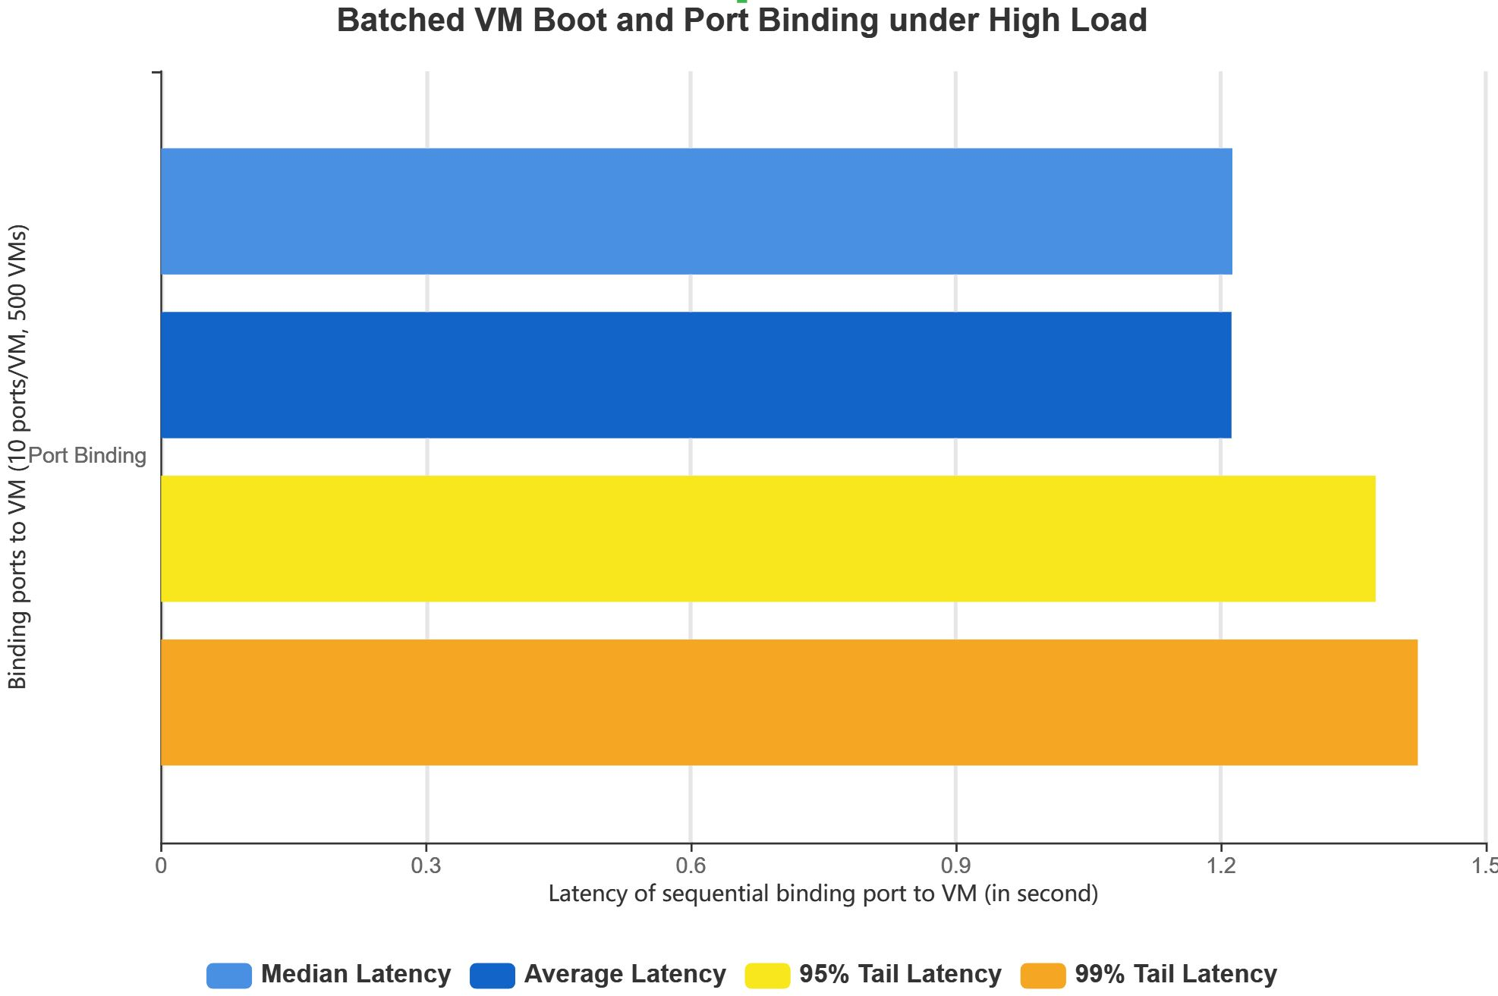
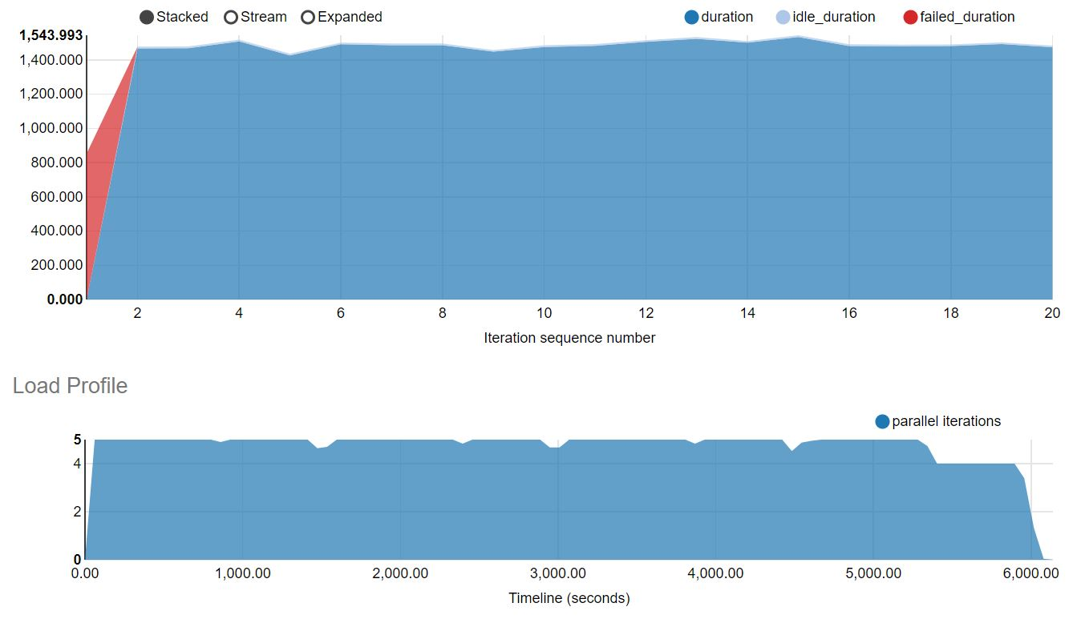
Sustainability under High Load (cont’d)
Deploy 500 VMs in parallel to 19 compute nodes and attach 10 ports to each VM, accumulated number of 5,000 ports in a batch

Slide 19
Reach 97% success rate for 1,000 concurrent VMs
Failure caused by client (Nova) and Keystone issues
Complete 20K VMs Test in 3,264 sec
Neutron reaches 100% success rate only for concurrency level = 50
Success rate drops down to 20% for concurrency level = 200
Starting from 1,000 VMs, Nova and Keystone hit serious timeout issues due to resource limit (Nova hosted in 3 physical machines and Keystone hosted in 1 physical machine)
Alcor not yet reaches its performance bottleneck
Note:
The concurrency level is measured by the number of concurrent boot VMs (concurrent iteration # x VM boot # per iteration)
Test environment includes 3 controller nodes + 44 compute nodes

Slide 20
Test Setup:
OpenStack (exception Keystone) and Alcor are co-located in three RH2288 v2 servers.
Run 600 iterations, each with 5 port creation and 5 port update requests.
100x Port Throughput (with latency at ~3 seconds)
1. Neutron port creation latency at 2.95 seconds when RPS = 5.
2. Alcor port creation latency at 2.85 seconds when RPS = 500.
3. Alcor consistently achieves low port list latency (under 600 ms).
10+x Throughput at performance tipping point (defined by 100% success rate):
1. Neutron could stay at stable status only up to RPS 50, after which Neutron hangs.
2. While Alcor could push all the way up to RPS 500 with 100% success rate.

Slide 21
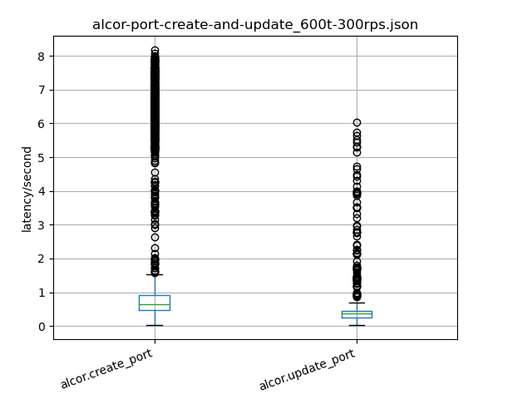
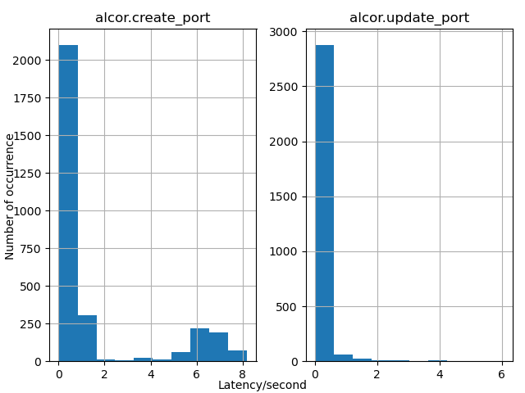
Create/Update Latency Distribution for High RPS 300
Alcor Setup under High RPS 300 (about 10K ports/minute):
Run 600 iterations, each with 5 port creation requests and 5 port update requests
Collect 3,000 port creation traces and 3,000 port update traces
Calculate mean, 25 percentile, 75 percentile etc.
75% percentile of requests under 1 seconds
Long tail latency caused by cold DB start and could be further improved

Slide 22
Test Setup:
OpenStack (exception Keystone) and Alcor are co-located in three RH2288 v2 servers.
Run 600 iterations, each with 10 port creation requests and 1 port list requests.
Alcor Resilience to High Stress
1. Similar to the Create/Update Scenario, Neutron could stay at stable status only up to RPS 50, after which Neutron hangs.
3. While Alcor could push all the way up to RPS 500 with 100% success rate. This is equivariant to 30,000 ports per minute.

Slide 23
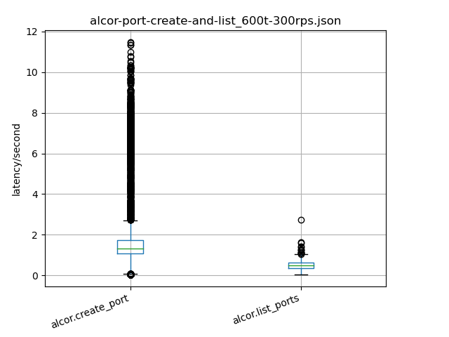
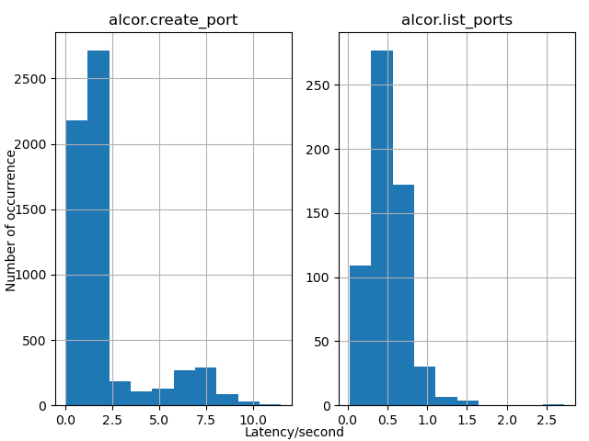
Create/List Latency Distribution for High RPS 300
Alcor Setup under High RPS 300 (about 18K ports/minute):
Run 600 iterations, each with 10 port creation requests and 1 port list requests
Collect 6,000 port creation traces and 600 port list traces
Calculate mean, 25 percentile, 75 percentile etc.

Slide 24
Alcor Project
Architecture Overview
Component Snapshot and Development Status
Performance Comparison with OpenStack Neutron
Scalability Test Framework
Migration Plan from Neutron
11/30 New Features
L3 Routing by Alcor Distributed Router
Distributed DHCP Programming

Slide 25
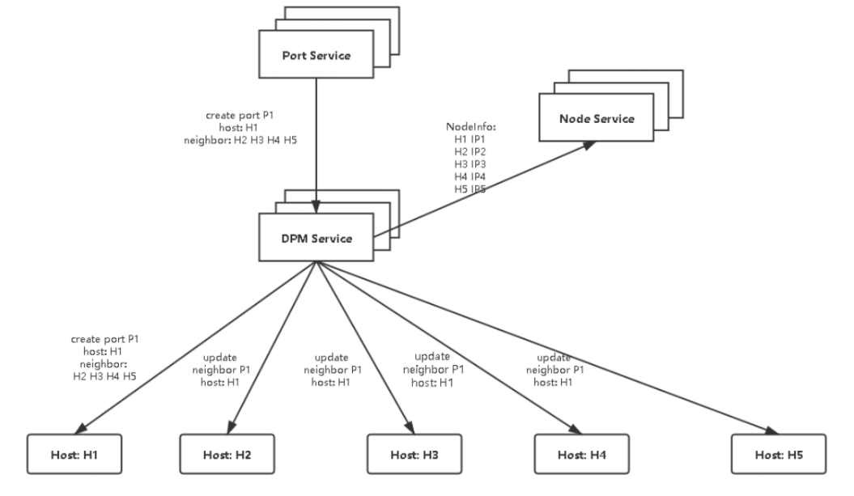
Scalability Test Setup
Alcor deployed in Kubernetes
Port Service Simulator
Batch construct port create/update messages
Alcor Agent Simulator
Listen to grpc port
Receive and drop message
Record timestamp of message reception and total number of received messages
Ansible deployment scripts
Use to launch and shut down simulator clusters
Collect and process logs
Monitoring scripts
Measure CPU, memory, IO, networking utilization
Deployed along with DPM

Slide 26
gRPC Fast Path Setup
Start DPM clusters and deploy monitoring scripts
Use Ansible scripts to launch 1M Alcor Agent simulators in 20 machines
Launch Port Service simulators and starting sending port creation/update messages to DPM
Watch DPM logs until batched messages are received and processed
Verify DPM receives and processes messages correctly
Use monitoring scripts to catch system resource utilization information during testing

Slide 27
Baseline w/ Single DPM, Single Port Creation, gRPC path
Note: This is a result that will be used as a baseline only for comparison.
Test Setup:
Use one single instance of data plane manager
X-axis represents number of ports, each is hosted in a simulated node
Key Observation:
Even with single instance, gRPC fast path scales well up to 10K nodes with distribution latency under 5s.
Over 10K nodes, the latency with one instance increases linearly by VPC size. We are exploring multiple DPM instances + DPM service partitioning to leverage DPM concurrency.

Slide 28
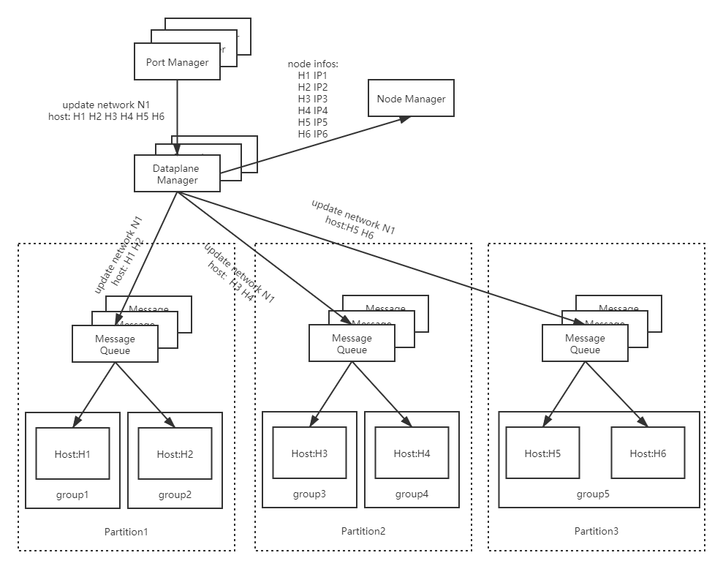
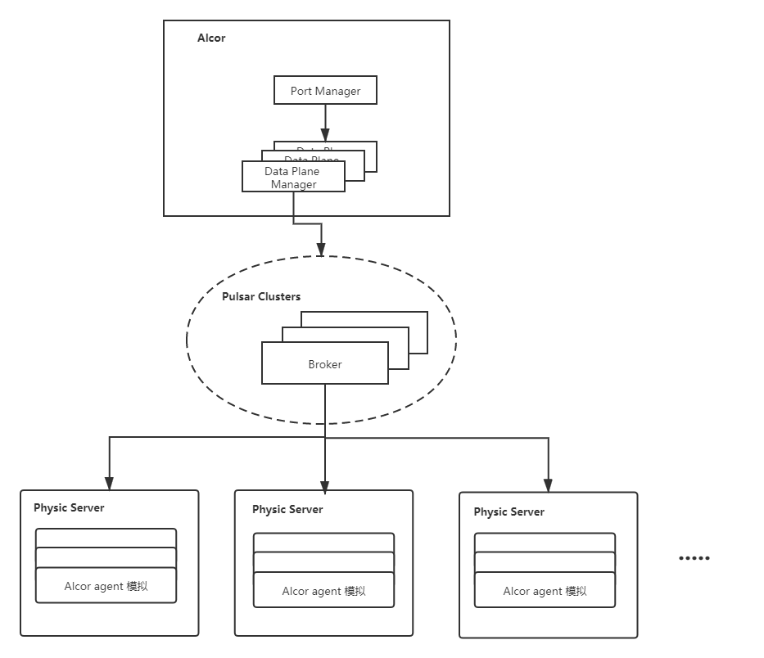
MQ Scaling Path Setup

Slide 29
MQ Scaling Path with Alcor Delta Update
Key Technique:
Alcor Delta Update supports sending incremental update to a new port’s L2/L3 neighbors, which cut latency and reduce MQ load.
Test Setup:
Use one single instance of data plane manager
Apache Pulsar is deployed in a 3-node cluster
X-axis represents number of ports, each is hosted in a simulated node
Key Observation:
With topic/host ratio at 1:100, MQ scaling path supports port create/upgrade in 60K ports VPC with reasonable latency and no message loss, where its distribution latency is under 20 second for single-layer option.
We are further validating MQ concurrency and throughput.

Slide 30
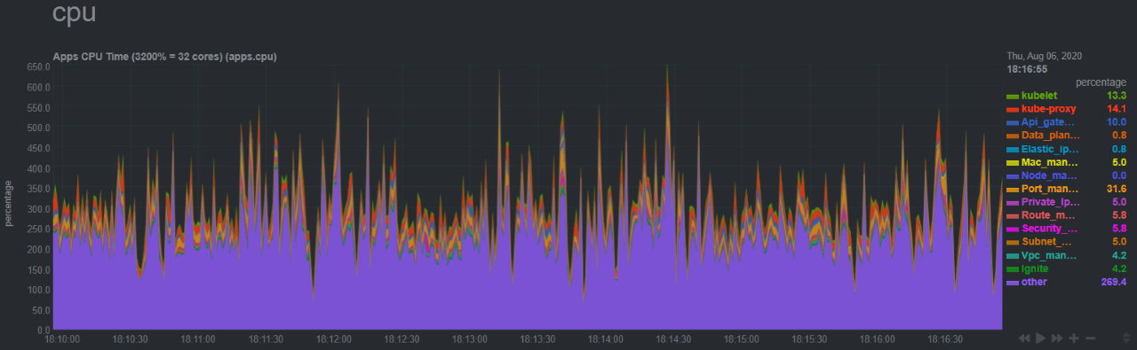
Alcor Monitoring
Enables metric collection to monitor control plane resource utilization
Monitor at various levels, from container pod, to microservice and to a host
Zoom into every microservice pod and infra pod
Include comprehensive metrics like cpu, ram, io, and network etc.

Slide 31
Alcor Project
Architecture Overview
Component Snapshot and Development Status
Performance Comparison with OpenStack Neutron
Scalability Test Framework
Migration Plan from Neutron
11/30 New Features
L3 Routing by Alcor Distributed Router
Distributed DHCP Programming

Slide 32
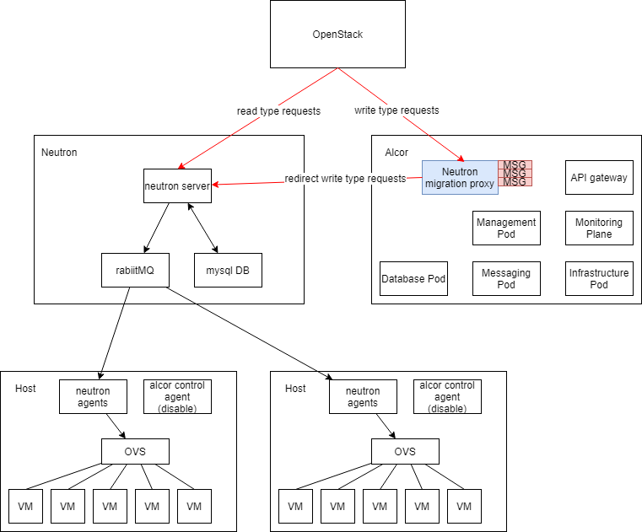
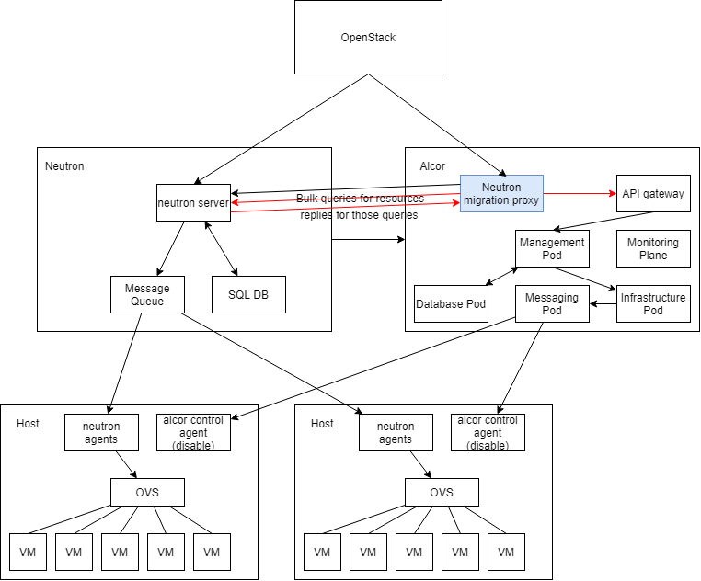
Migration Plan from Neutron
Step 1: Active Neutron and passive Alcor with request caching
Step 2: Proactive request processing by Alcor

Slide 33
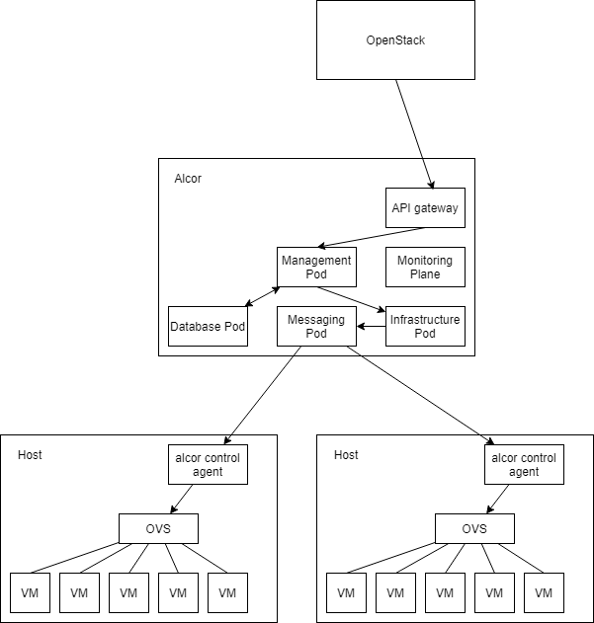
Migration Plan from Neutron (cont’d)
Step 3: Seamelss Transition to Active Alcor
Link: https://github.com/futurewei-cloud/alcor/blob/master/docs/modules/ROOT/pages/deploy_related/deployment.adoc

Slide 34
Alcor Project
Architecture Overview
Component Snapshot and Development Status
Performance Comparison with OpenStack Neutron
Scalability Test Framework
Migration Plan from Neutron
11/30 New Features
L3 Routing by Alcor Distributed Router
Distributed DHCP Programming

Slide 35
Alcor L3 Routing
Alcor Routing Overview
Alcor Routing Innovation
Service Architecture and Workflow
Alcor Distributed Router Packet Flow
Powered by Alcor Distributed Router
Involves multiple components
Route Manager (20+ new APIs)
Subnet Manager
Port Manager
Data-Plane Manager
Controller-Agent Communication Channel
Alcor Control Agent

Slide 36
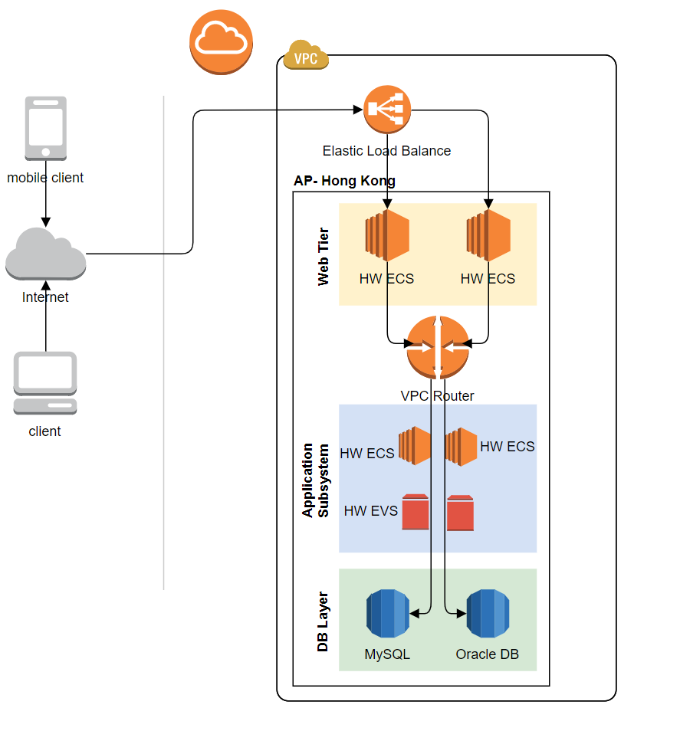
Alcor Routing Overview
Public cloud routes traffic between cloud provider, on-premises and Internet resources.
Enable L3 routing between customer subnets as the first step
Create a routing table for each subnet within Alcor virtual network
Add system routes to the routing table
Alcor routes outbound traffic from a subnet based on the routes in the subnet’s routing table
Allow user-defined routes (UDR)
Specify next-hop in the routing rule for traffic routed to virtual appliance (for DPI etc.), virtual network gw (for VPN etc.), Internet, or customized virtual network routing

Slide 37
Alcor Routing Innovation
Controller Innovation
Built on top of distributed microservices architecture
Each microservice managing its own resource and scaling independently with its own DB (Ignite)
Controller-Agent Communication
Introduce new NeighborState and RouterState top-level resources in GS message
Support delta update of neighbor ports for faster resource provisioning
Key difference: Top down (Alcor) vs. bottom up
Agent Innovation
Distributed design to enable host-to-host direct communication for L3 routing
Use highly efficient and on-demand OpenFlow rules
Reduce overhead by eliminating namespace, Linux devices, and iptables required by Neutron DVR

Slide 38
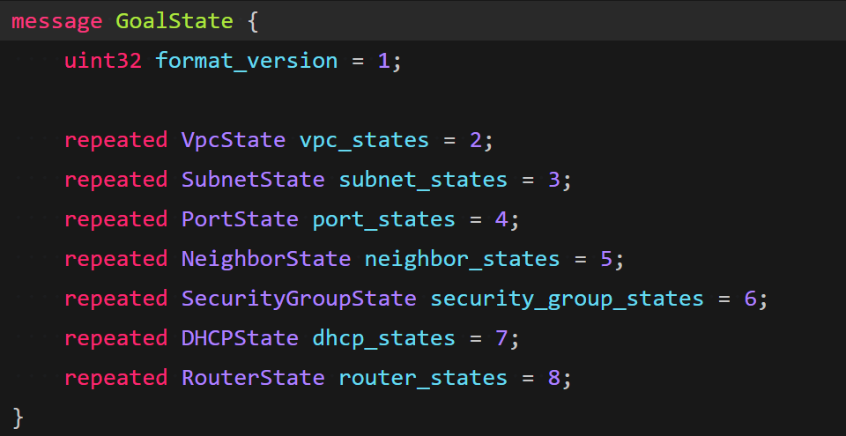
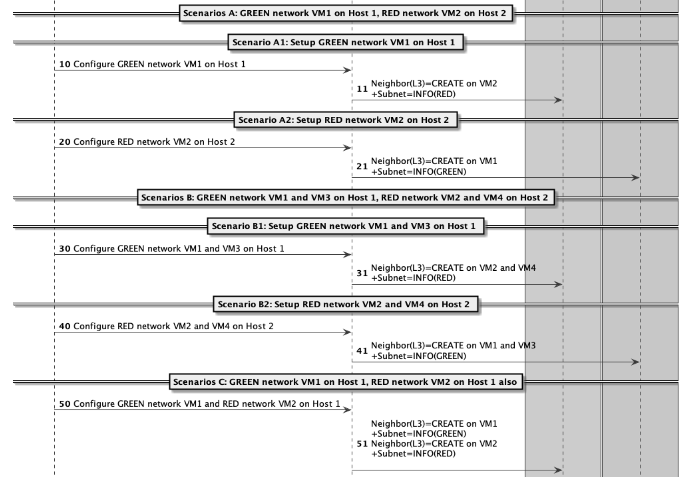
Alcor Routing Innovation
Controller Innovation
Built on top of distributed microservices architecture
Each microservice managing its own resource and scaling independently with its own DB (Ignite)
Controller-Agent Communication
Introduce new NeighborState and RouterState top-level resources in GS message
Support delta update of neighbor ports for faster resource provisioning
More optimization to come…
Agent Innovation
Distributed design to enable host-to-host direct communication for L3 routing
Use highly efficient and on-demand OpenFlow rules
Reduce overhead by eliminating namespace, Linux devices, and iptables required by Neutron DVR

Slide 39
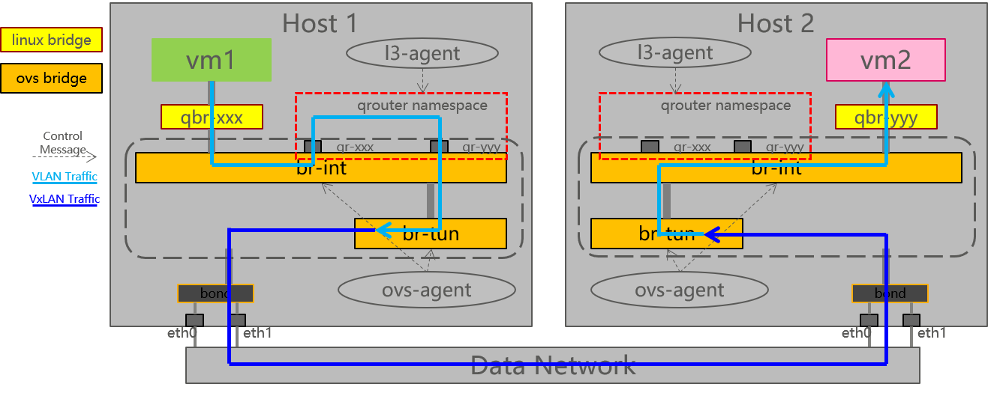
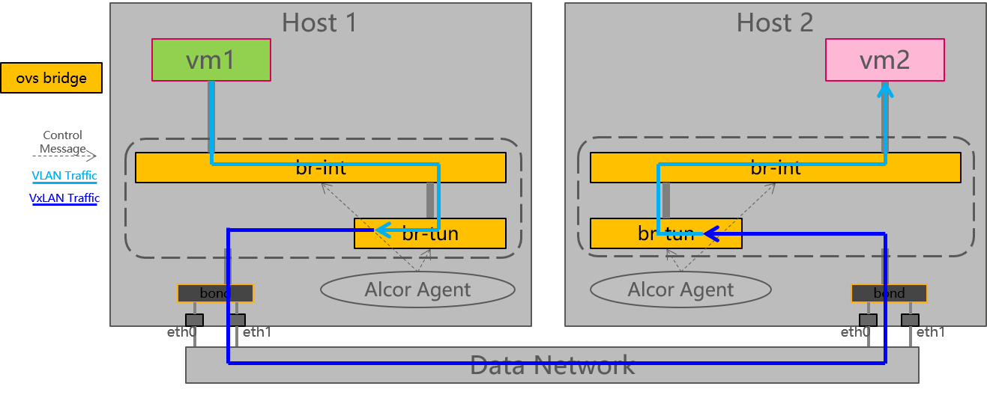
Alcor Routing Innovation
Neutron DVR packet flow
Controller Innovation
Built on top of distributed microservices architecture
Each microservice managing its own resource and scaling independently with its own DB (Ignite)
Controller-Agent Communication
Introduce new NeighborState and RouterState top-level resources in GS message
Support delta update of neighbor ports for faster resource provisioning
More optimization to come…
Agent Innovation
Distributed design to enable host-to-host direct communication for L3 routing
Use highly efficient and on-demand OpenFlow rules
Reduce overhead by eliminating namespace, Linux devices, and iptables required by Neutron DVR
Alcor Distributed Router packet flow
Notes:
Details:
qrouter namespace: Every tenant has one namespace on the compute host.
qr-xxx/qr-yyy: Internal gw ports for vm1 and vm2. ，所有节点上的qr口网关地址的IP地址和mac地址都一样。
所有的虚拟机、qr口的IP地址/mac地址都是由neutron分配，相关的路由和arp在CNA全部静态配死。
ARP过程:
虚拟机发出的arp，只会到本地qr网关；
qr网关口发出的arp，在br-int上normal（为了让本地虚拟机能收到，br-1上的patch port只走公网流量），在br-tun上全部丢弃（不会发到物理网络）
Communication：
1）Source：VM1 sends packet normal to qr-xxx，qrouter queries routing and static arp, destination MAC=vm2，then forward packet to br-tun for VxLan processing
2）Destination 目的端：报文先到br-tun剥去vxlan，在br-int先转换成内部vlan走normal，然后将src mac修改成qr-yyy发送到VM2。

Slide 40
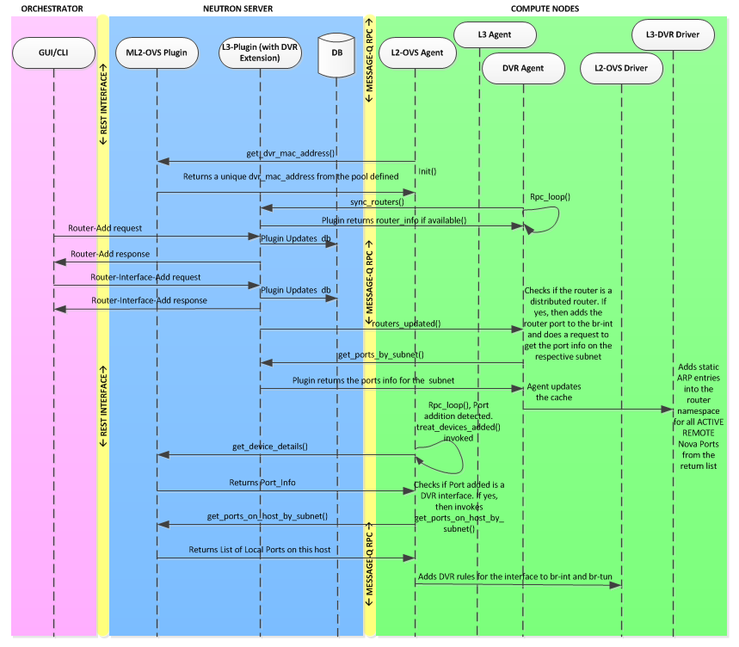
Background: Neutron L3 Routing
Neutron DVR control-plane workflow
Neutron DVR data-plane packet flow
Source: https://wiki.openstack.org/wiki/File:Router-add-interface-flow-that-triggers-different-Plugins-agents.png

Slide 41
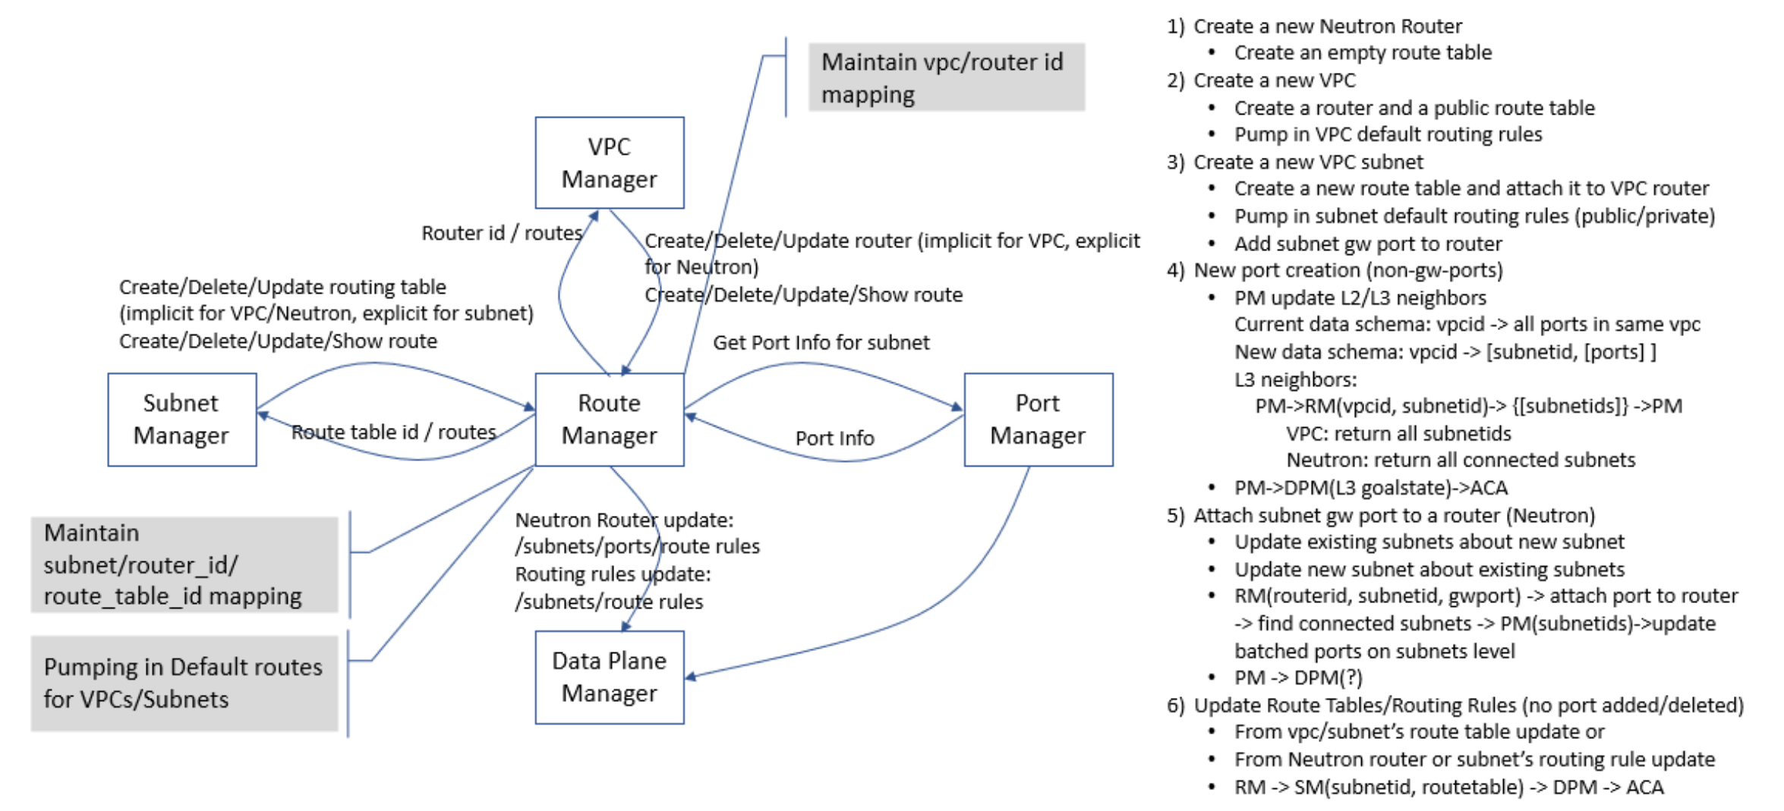
Service Architecture and Control-Plane Workflow
Alcor Routing Design: https://github.com/futurewei-cloud/alcor/blob/master/docs/modules/ROOT/pages/mgmt_services/route_manager.adoc

Slide 42
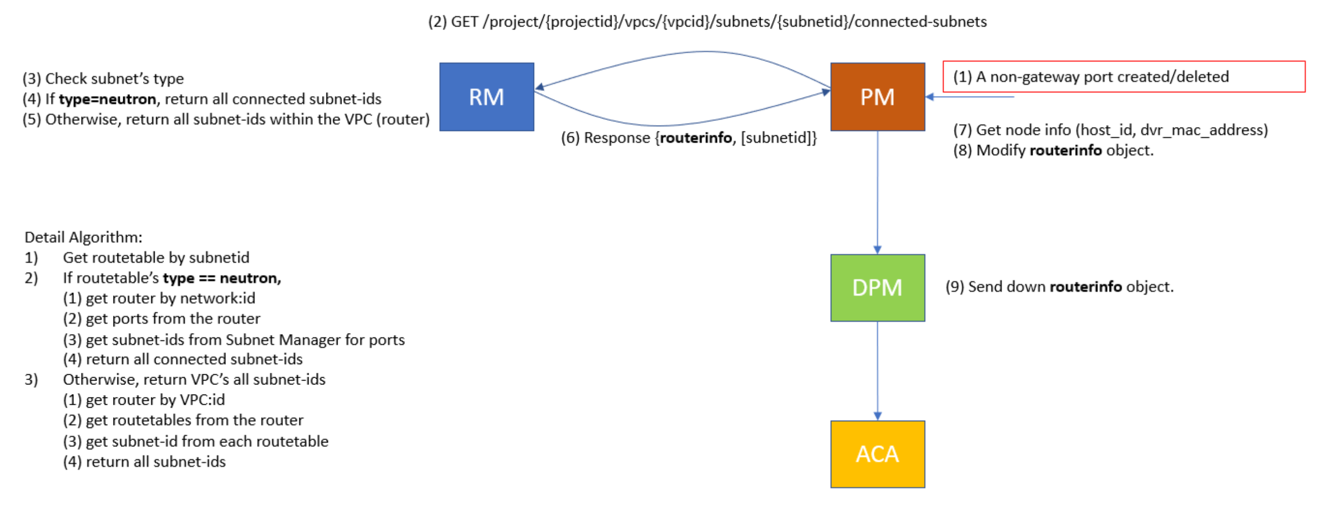
Key Workflow: Add/Delete Non-GW Ports
Alcor Routing Design: https://github.com/futurewei-cloud/alcor/blob/master/docs/modules/ROOT/pages/mgmt_services/route_manager.adoc

Slide 43
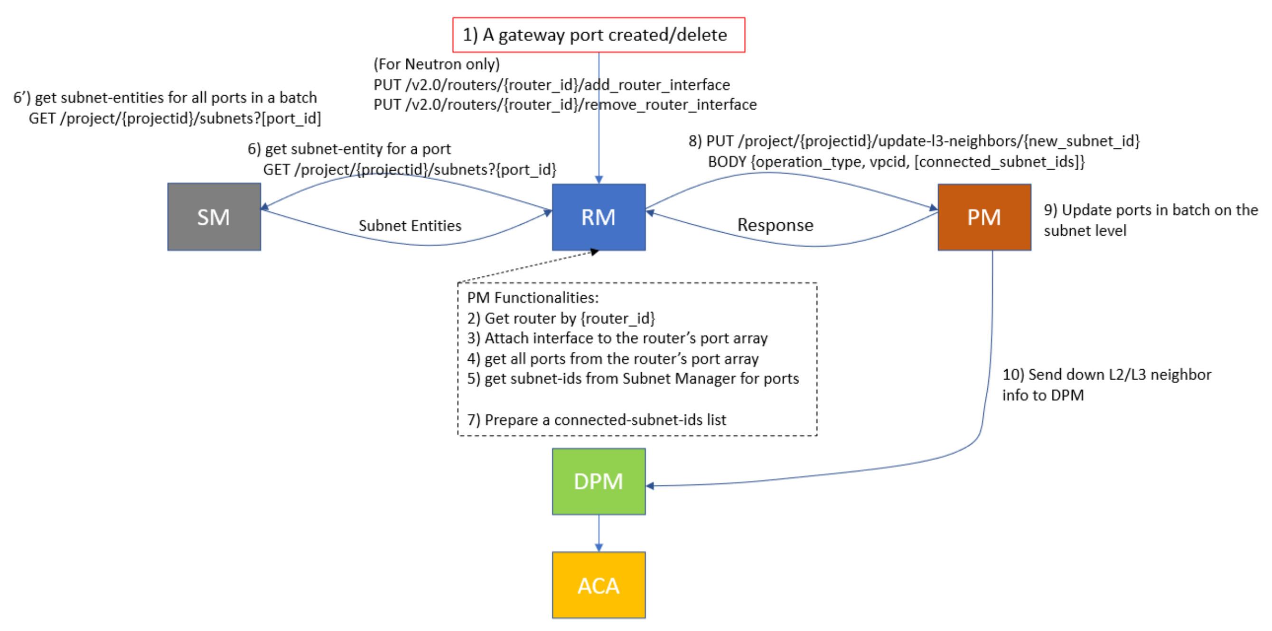
Key Workflow: Add/Delete GW Ports
Alcor Routing Design: https://github.com/futurewei-cloud/alcor/blob/master/docs/modules/ROOT/pages/mgmt_services/route_manager.adoc

Slide 44
Neutron DVR
Host 1
Host 2
linux bridge
Compute node
vm1
l3-agent
l3-agent
vm2
ovs bridge
qbr-xxx
qrouter namespace
qrouter namespace
qbr-yyy
Control Message
qr-xxx
qr-yyy
qr-xxx
qr-yyy
VLAN Traffic
br-int
br-int
VxLAN Traffic
br-tun
br-tun
bond
ovs-agent
ovs-agent
bond
eth0
eth1
eth0
eth1
Data Network

Slide 45
Alcor Distributed Router
Host 1
Host 2
Compute node
vm1
vm2
ovs bridge
Control Message
VLAN Traffic
br-int
br-int
VxLAN Traffic
br-tun
br-tun
bond
Alcor Agent
Alcor Agent
bond
eth0
eth1
eth0
eth1
Data Network

Slide 46
Alcor Distributed Router – Packet Flow
Host 1
Host 2
Compute node
vm1
vm2
ovs bridge
1 | Vm1 mac | Green gw mac | Vm1 ip | Vm2 ip
5 | Red gw mac | Vm2 mac | Vm1 ip | Vm2 ip
Control Message
VLAN Traffic
br-int
br-int
VxLAN Traffic
4 | Red vlan | Host1 DVR mac | Vm2 mac | Vm1 ip | Vm2 ip
2 | Red gw mac | Vm2 mac | Vm1 ip | Vm2 ip
br-tun
br-tun
bond
Alcor Agent
Alcor Agent
bond
eth0
eth1
eth0
eth1
Data Network
3 | Red VNI | Host1 DVR mac | Vm2 mac | Vm1 ip | Vm2 ip

Slide 47
Alcor Distributed DHCP Programming
Compute Node
Alcor Control Agent
DHCP Server
On-host distributed DHCP
Proactively plumb DHCP OVS rules to compute nodes
Use local DHCP server to respond to DHCP request (compared with Neutron’s centralized DHCP server on network nodes)
Eliminate namespace, Linux devices, and Dnsmasq process required by Neutron DHCP
moniter
Packet out
vconn
Packet-in
OVS
br-int
BOOTP/DHCPDISCOVER
DHCPACK
VMs
10.0.1.0/24

Slide 48
Design docs are available here
Questions later?
Feel free to send email to Liguang Xie<lxie@futurewei.com> or raise questions on Alcor Slack Channel

